Slide 1
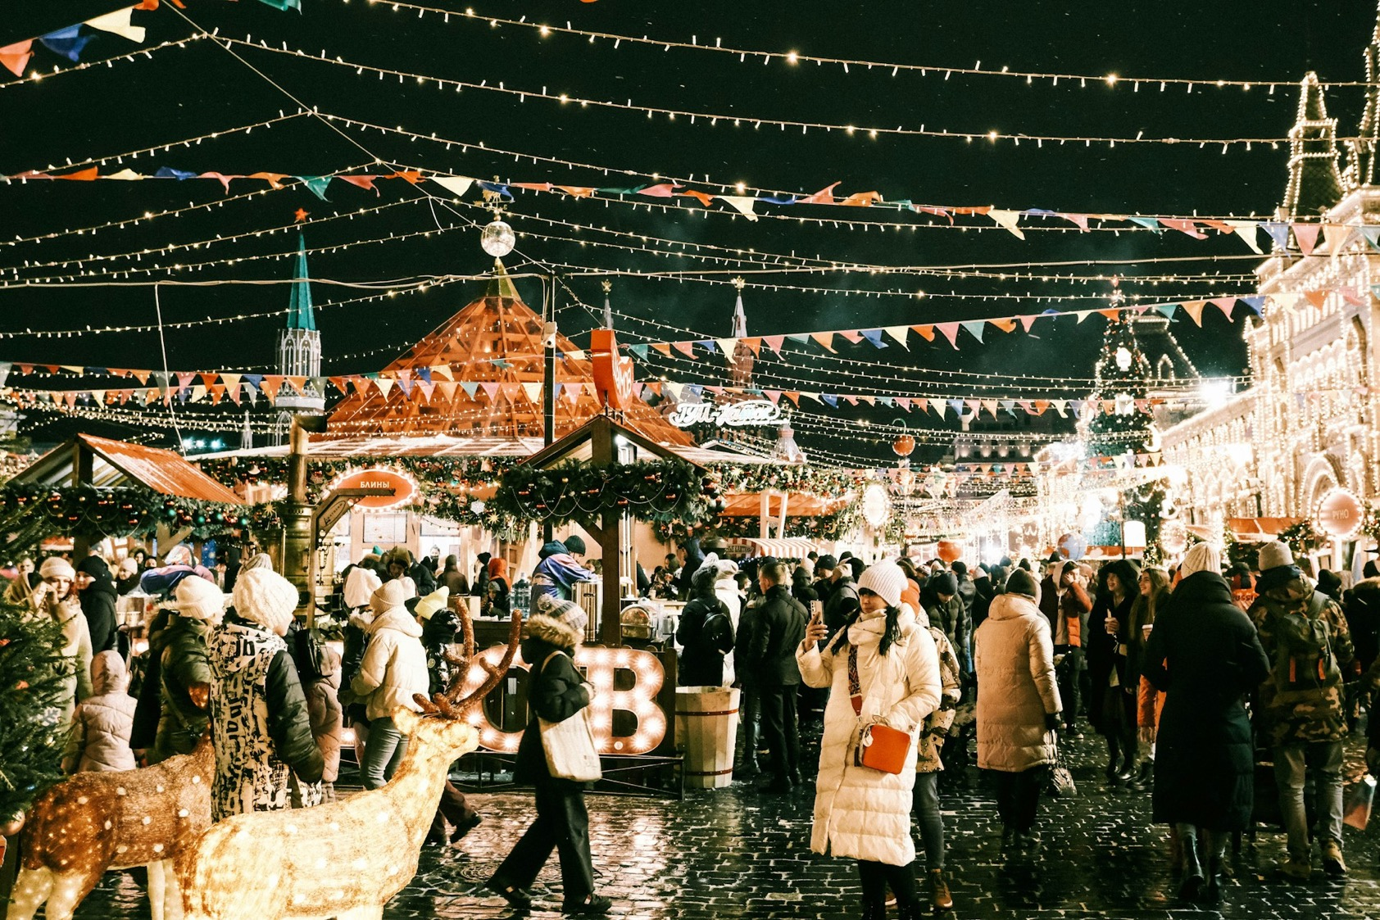

Notes:
https://unsplash.com/photos/a-crowd-of-people-walking-around-a-christmas-market-4sTyT-uuJWY

Slide 2
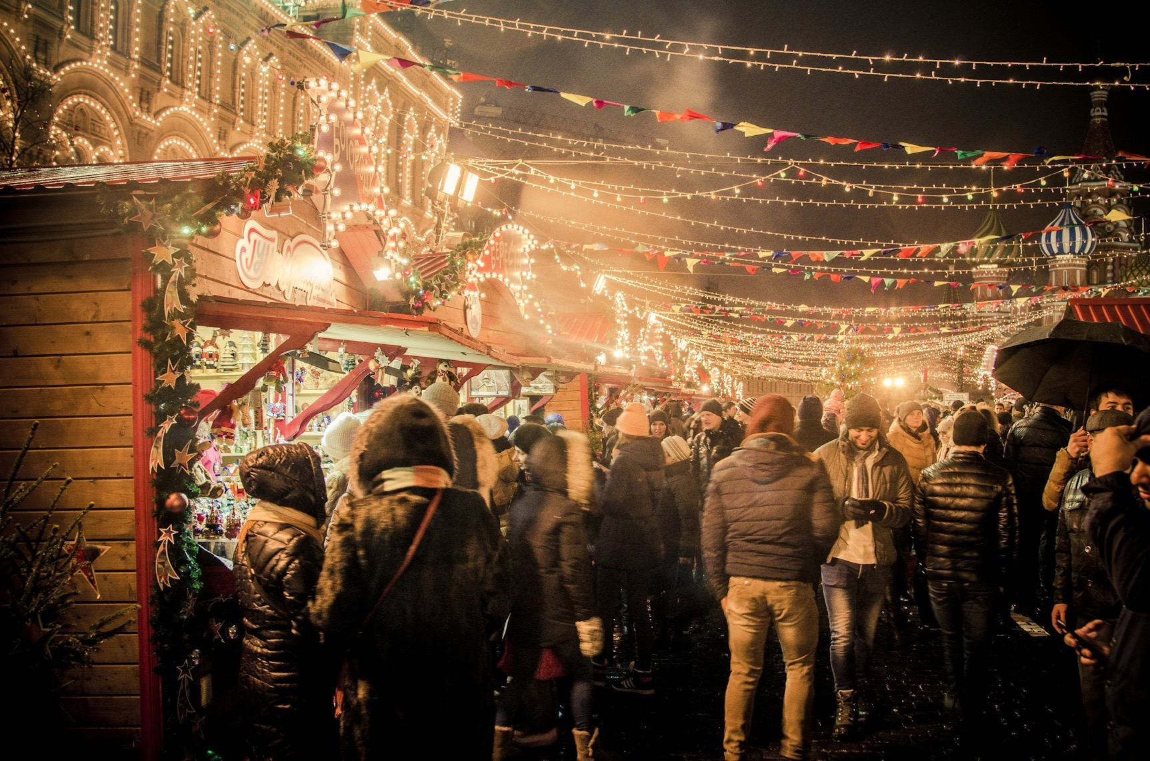

Notes:
https://unsplash.com/photos/group-of-people-standing-near-amusement-park-PKzkV7rVcJg

Slide 3

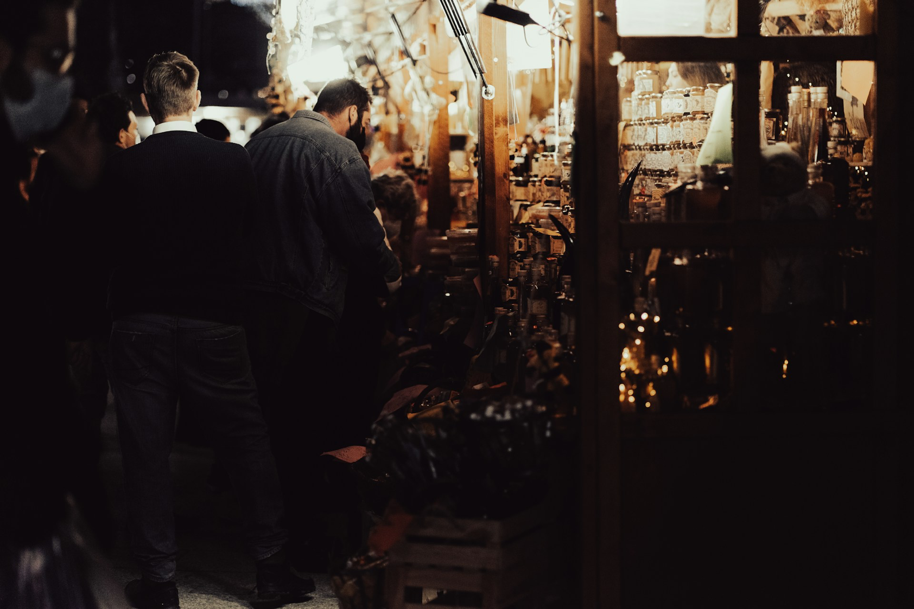
Notes:
https://unsplash.com/photos/a-group-of-people-standing-around-a-store-BliXB4V2yDk

Slide 4
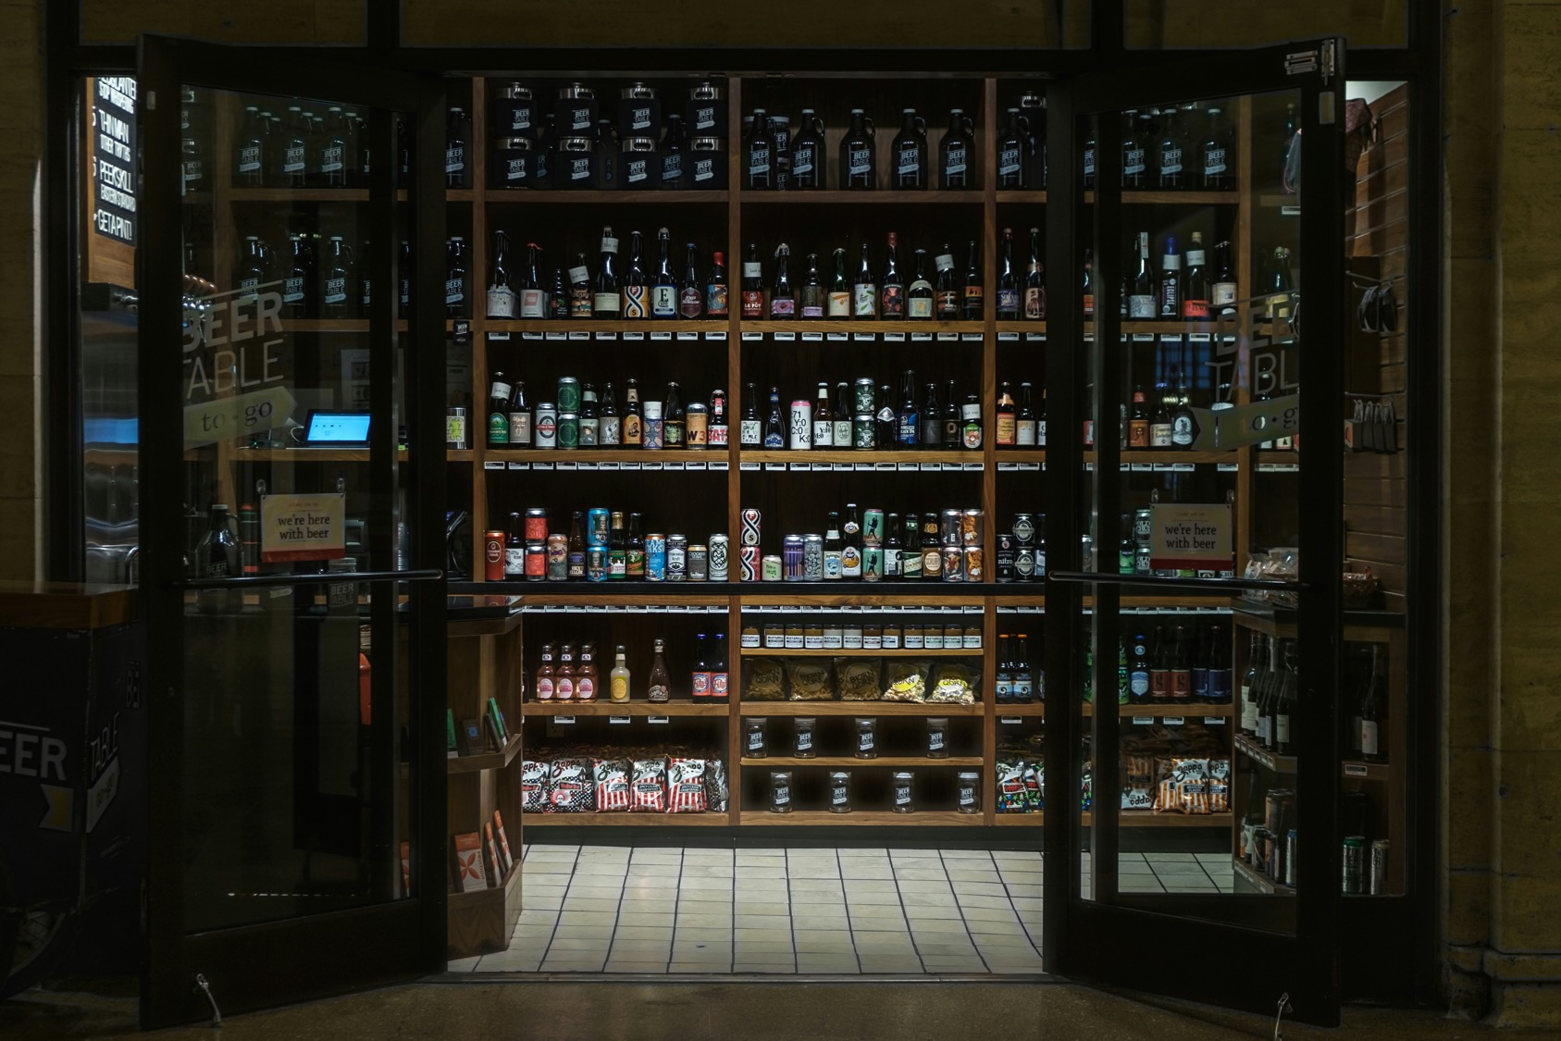

Notes:
https://unsplash.com/photos/brown-wooden-wine-racks-7dpHzyA7rb8

Slide 5

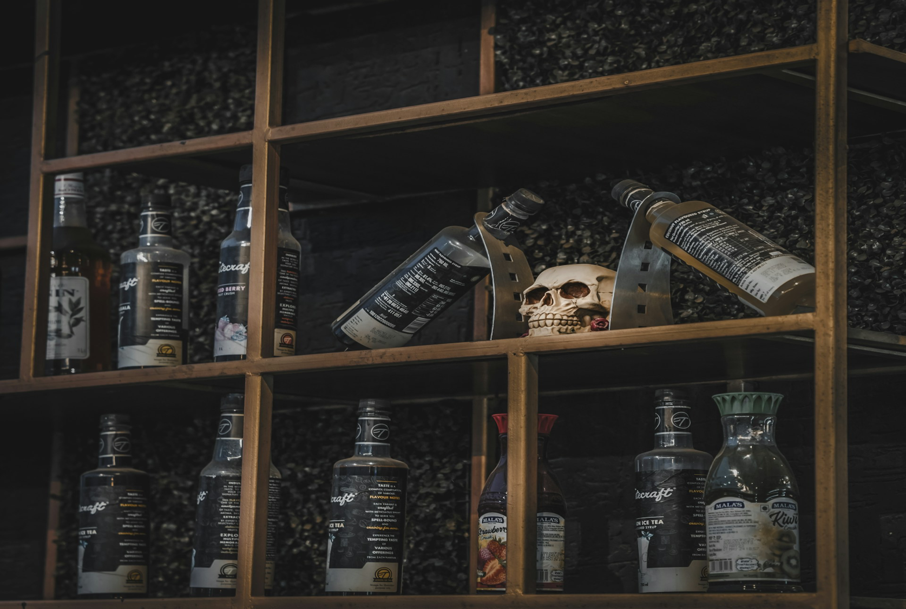
Notes:
https://unsplash.com/photos/a-wooden-shelf-filled-with-bottles-and-a-skull-uqQXlszsCe8

Slide 6

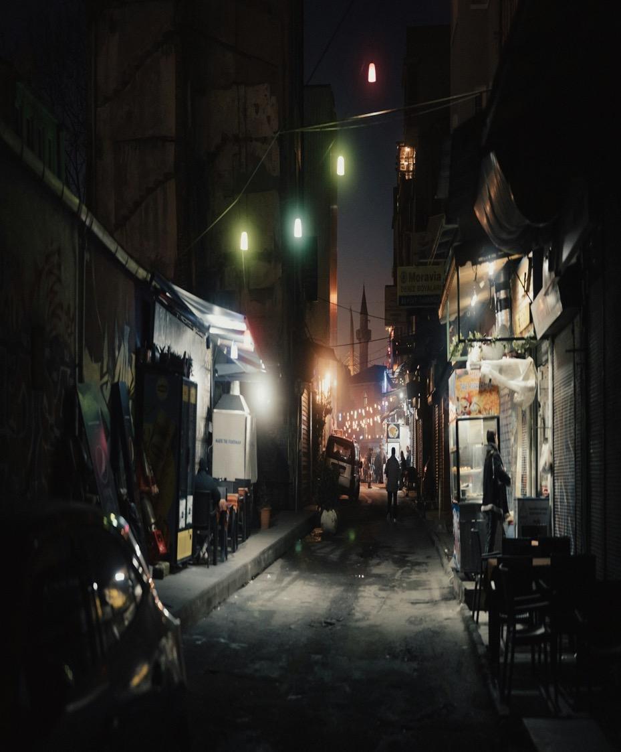
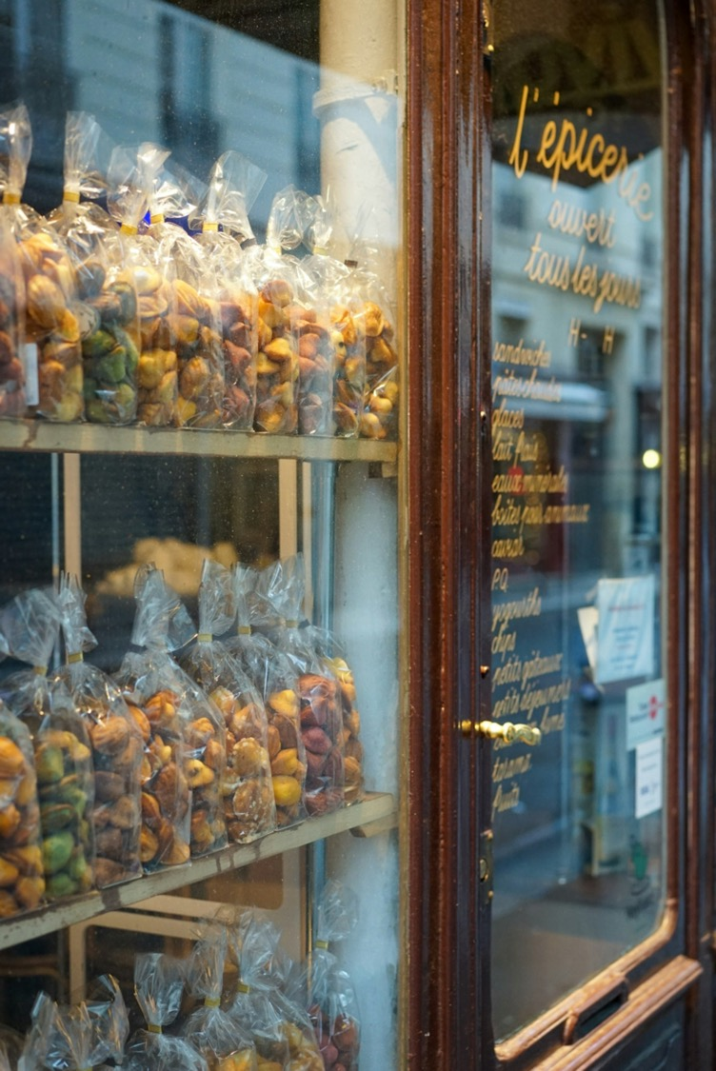
Notes:
https://unsplash.com/photos/a-city-street-at-night-with-cars-parked-on-the-side-of-the-street-aBZrp8MlD6c
https://unsplash.com/photos/food-packs-on-shelves-MdslXaAyhRM

Slide 7

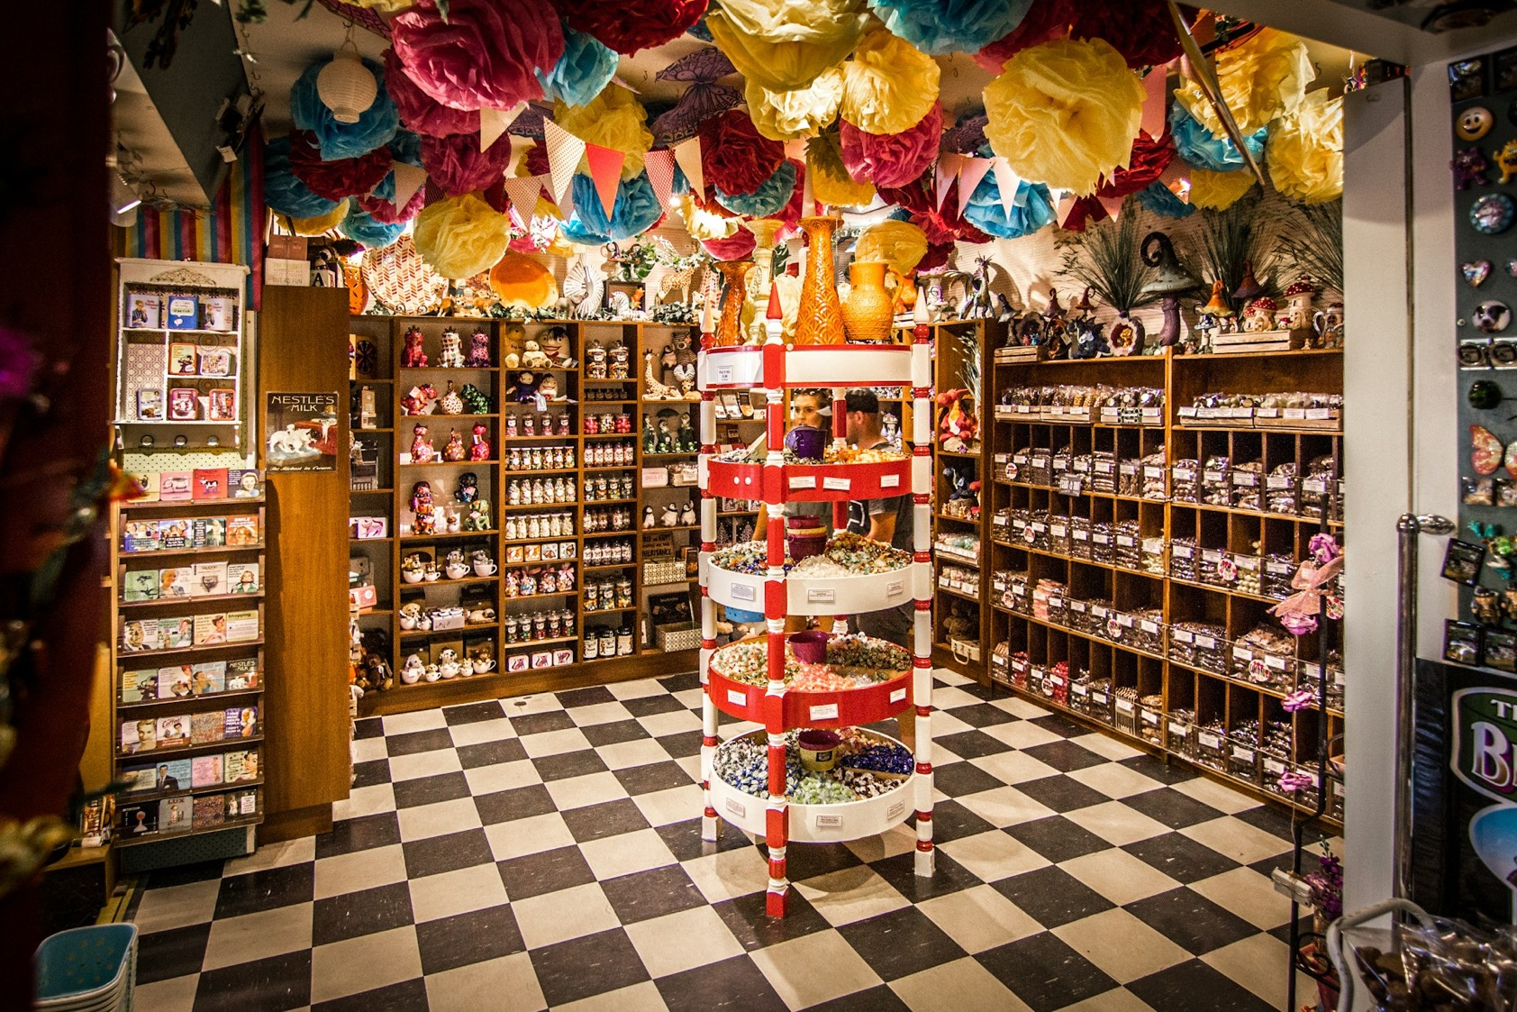
Notes:
https://unsplash.com/photos/brown-wooden-shelf-q2i_zb0zdB8

